Slide 1
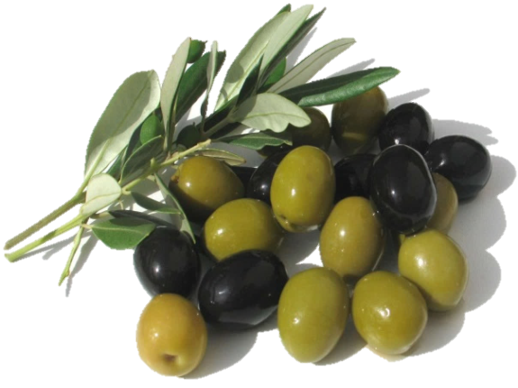
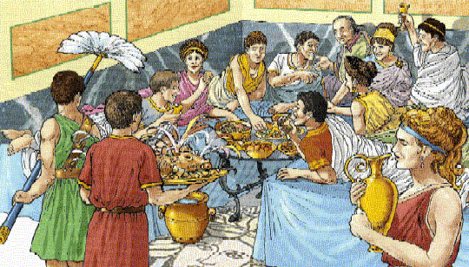
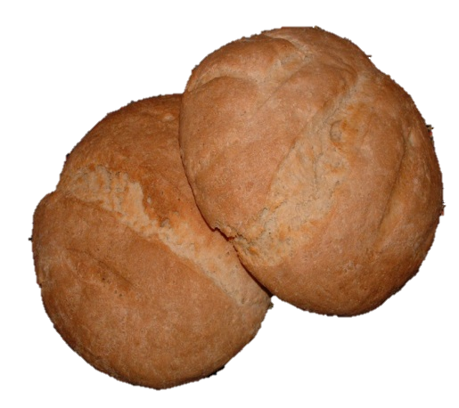
What was a Roman Banquet like?

Slide 2
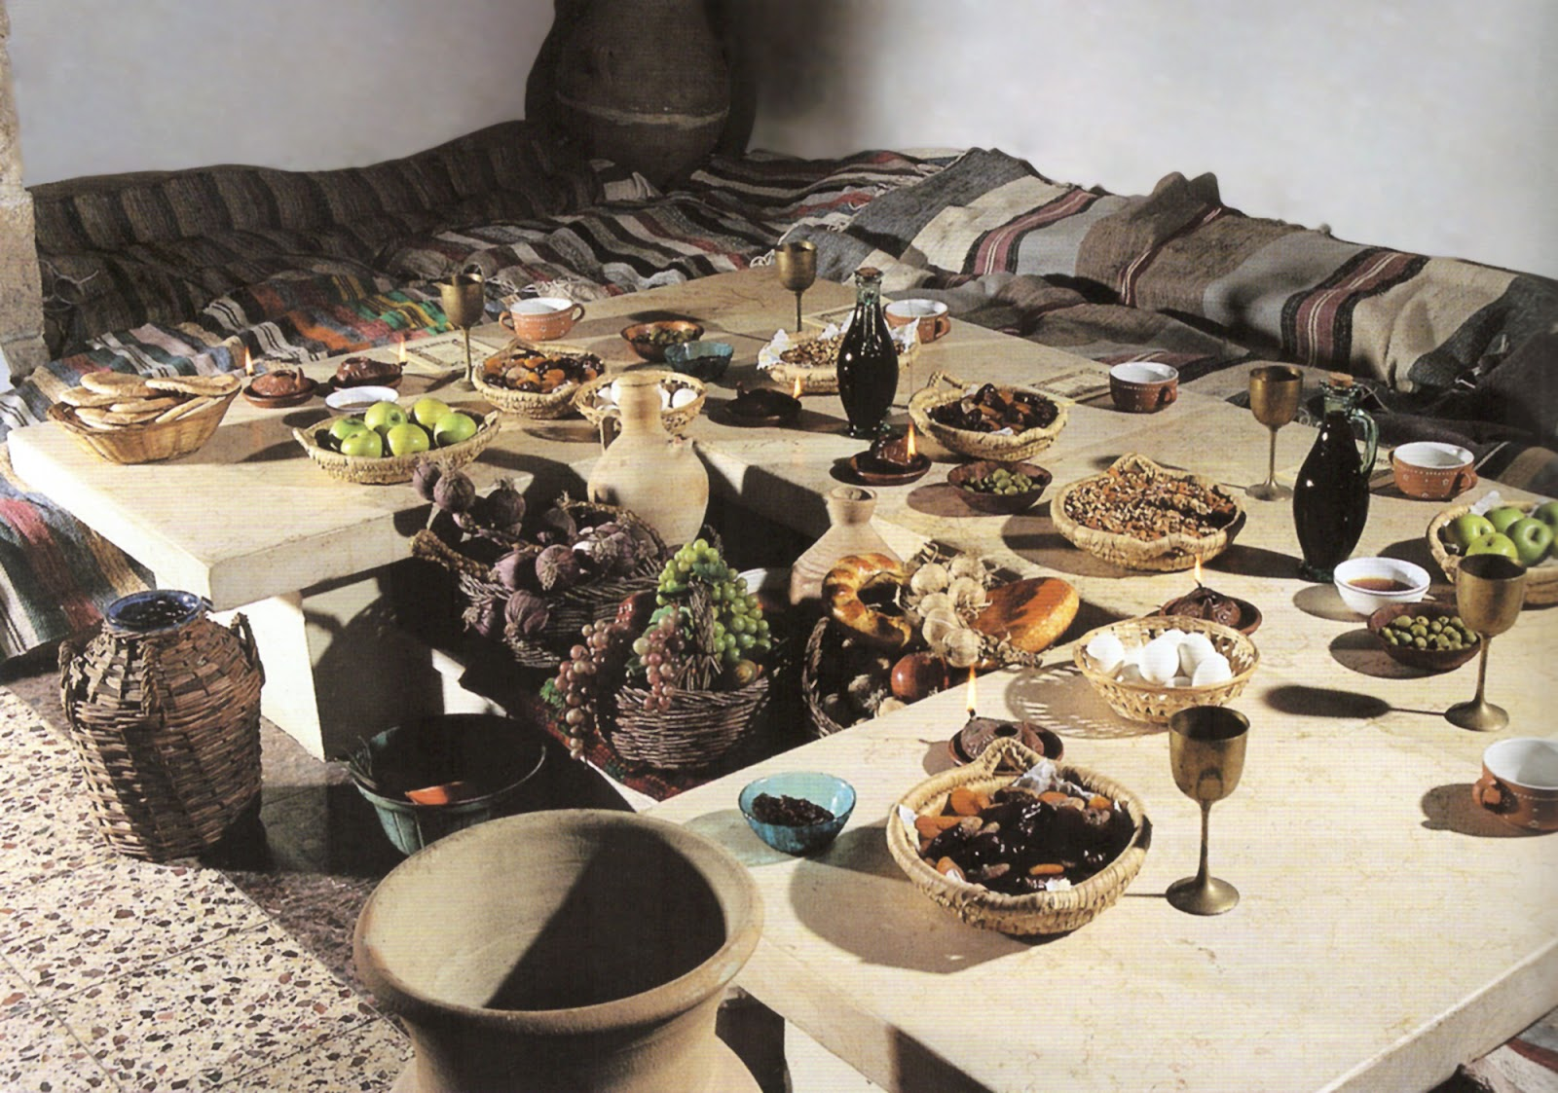

Slide 3
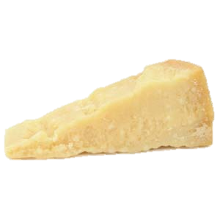
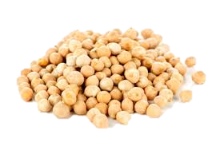
‘Erebinthoi syn Xeroi Tyroi’
Chickpeas and Cheese
Translation:
Chickpeas boiled in water are customarily eaten by many people, some serving them plain, others seasoning them with a little salt. Those who live where I do make a sort of flour out of dried cheese and sprinkle the chickpeas with this.

Slide 4
Countdown
http://www.online-stopwatch.com/countdown-timer/

Slide 5
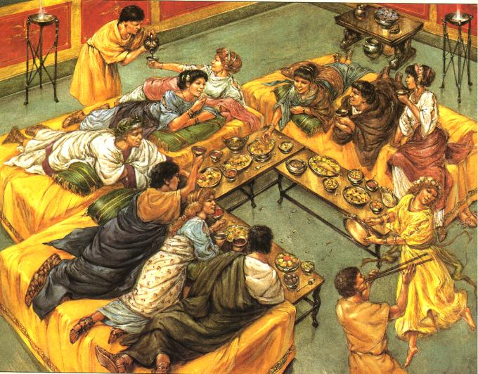
Our Roman Banquet

Slide 6
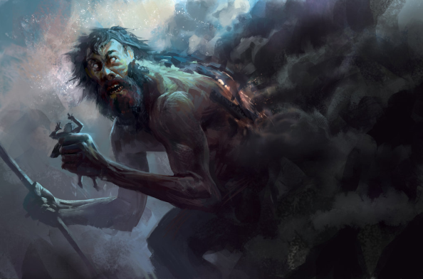
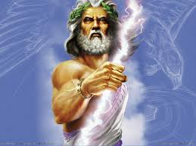
The Titans vs The Olympians
The Titans ruled before the Olympians.
Cronos was the leader of the Titans
Cronos ate his children out of fear that they would take over.
One of his sons, Zeus, was hidden from Cronus and later freed his siblings from
Cronos
The Olympians are the children of Cronos who escaped from his belly and fought the Titans for rule of the heavens.
Zeus, son of Cronus, was the leader of the Olympians
Zeus

Slide 7
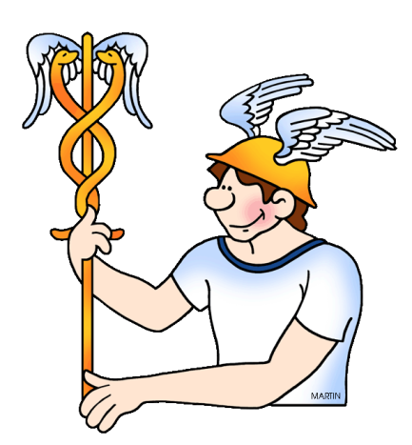
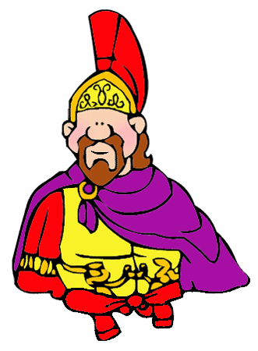

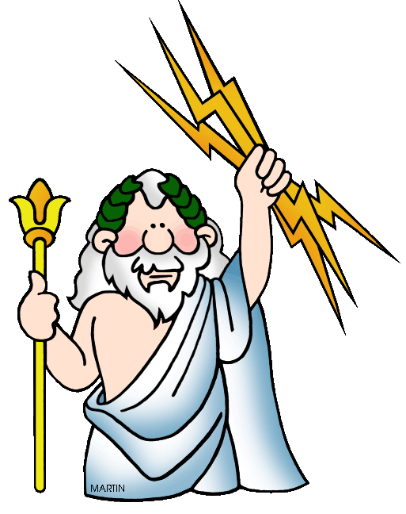
The Roman Gods
What do you remember about the roman gods?
How many can you name?
Why did the Romans have so many gods?

Slide 8
Are you Jupiter?

Slide 9
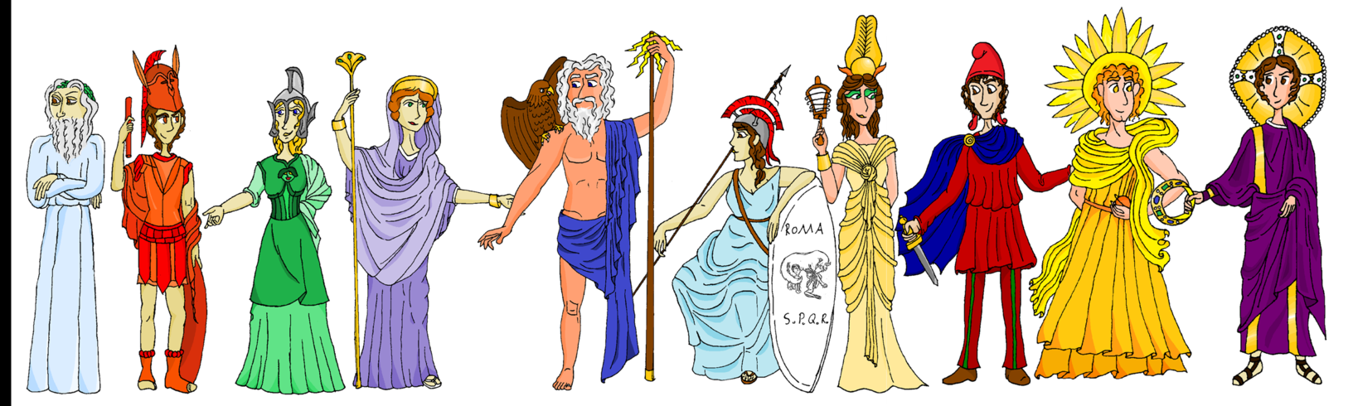
Presentation of the Gods

Slide 10
Jupiter’s Verdict

Slide 11
Music Video
https://www.youtube.com/watch?v=E-LemeejdjA

Slide 12
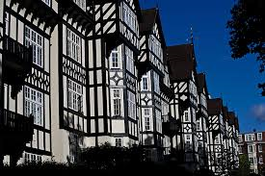
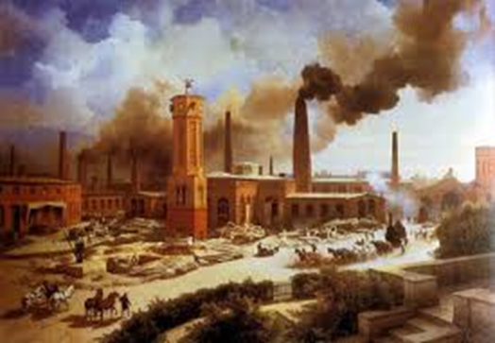
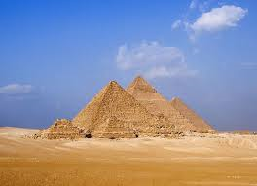
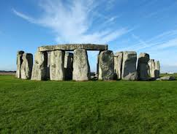

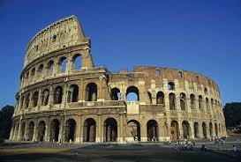
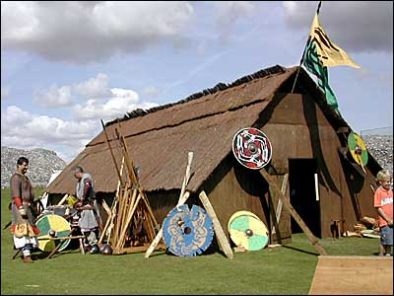
Timeline Pictures

Slide 13
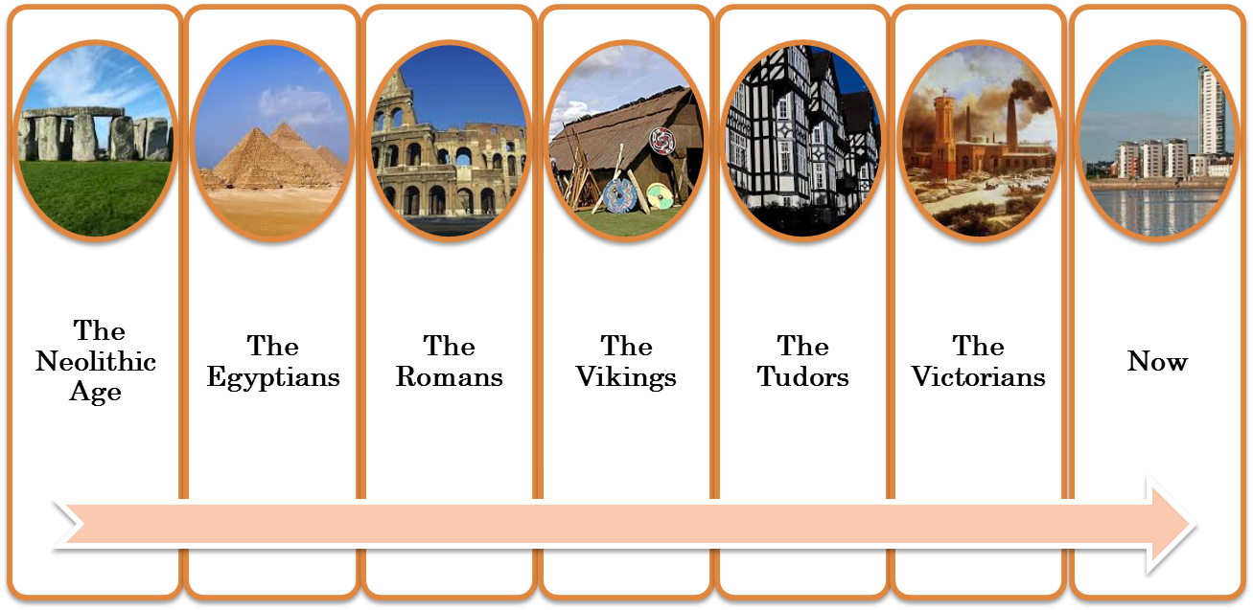
Timeline

Slide 14
The End

