Slide 1
Latin verbs

Slide 2
Do you remember…
SUBJECT:
Words end with
–a/-us
puella = table
murus = wall
mus = mouse
DIRECT OBJECT:
Words end with
–am/-um/-em
puellam = girl
Murum = wall
Murem = mouse

Slide 3
Different tenses…
In English we use different tenses…
… SO DID THE ROMANS!
The PRESENT TENSE is
what is happening NOW!
I am eating
I eat
The girl cuddles the kitten
The girl is cuddling the kitten

Slide 4
Different tenses…
In English we use different tenses…
… SO DID THE ROMANS!
The FUTURE TENSE is
what WILL happen!
I will eat
The girl will cuddle the kitten

Slide 5
Different tenses…
In English we use different tenses…
… SO DID THE ROMANS!
The PAST TENSE is
what HAS ALREADY happened!
I have eaten
I ate
The girl cuddled the kitten
The girl has cuddled the kitten

Slide 6
Different tenses…
In English we use different tenses…
… SO DID THE ROMANS!
The PRESENT TENSE is what is happening NOW!
I am eating
I eat
The girl cuddles the kitten
The girl is cuddling the kitten

Slide 7
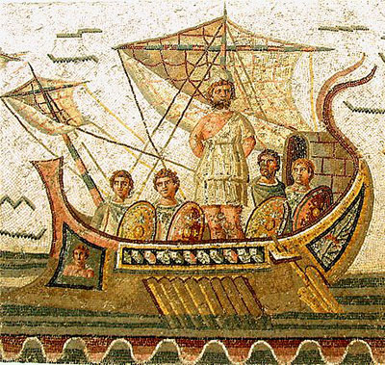
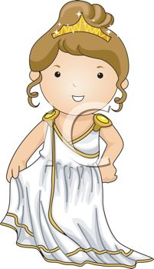
Verbs
amo
amas
amat
amo nautam
I love the sailor
amas nautam
you love the sailor
amat nautam
he/she/it loves the sailor
we love
you love
they love
I love
you love
he/she/it loves
amamus
amatis
amant
amamus puellam
we love the girl
amatis puellam
you love the girl
amant puellam
they love the girl

Slide 8
Nouns
nautae
nautas
puellae amant nautas
the girls love the sailors
nautae amant puellas
the sailors love the girls
nautae puellam amant
the sailors love the girl
nauta
nautam
puella amat nautam
the girl loves the sailor
puellam amat nauta
the sailor loves the girl
puella nautam amat
the girl loves the sailor
SUBJECT
DIRECT OBJECT
SUBJECT
DIRECT OBJECT

Slide 9
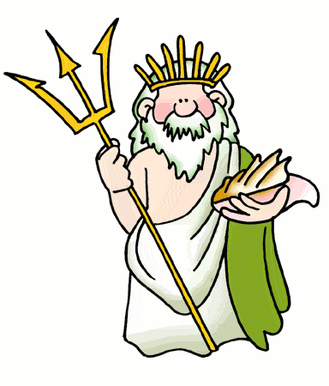
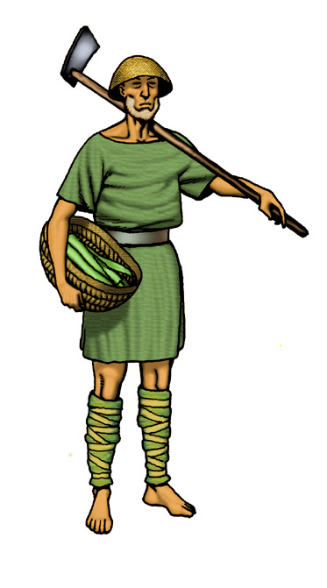
Two useful little words…
There are two small words which will help your sentences a lot …
et and non!
Nauta amat victoriam et barbas.
The sailor loves victory and beards.
Puella amat nautam et non agricolam.
The girl loves the sailor and not the farmer.

Slide 10
SPOT THE VERB!

Slide 11
pugno
I fight
verb

Slide 12
Graecia
Greece
noun

Slide 13
amat
he loves
verb

Slide 14
mater
mother
noun

Slide 15
Roma
Rome
noun

Slide 16
dormio
I sleep
verb

Slide 17
aqua
water
noun

Slide 18
habitamus
we live
verb

Slide 19
doces
you teach
verb

Slide 20
unus
one
number

Slide 21
pater
father
noun

Slide 22
mensa
table
noun

Slide 23
habitamus
we live
verb

Slide 24
habeo
I have
verb

Slide 25
agricola
farmer
noun

Slide 26
delemus
we destroy/ (delete)
verb

Slide 27
fama
fame, glory
noun

Slide 28
locus
place
noun

Slide 29
narras
you tell/(narrate)
verb

Slide 30
victoria
victory
noun

Slide 31
nauta
sailor
noun

Slide 32
navigant
they sail
verb

Slide 33
habitant
they live
verb

Slide 34
LATIN - QUIZ

Slide 35
If you love someone in Latin you say…
A - amo
A - amo
B - habito
C - pugno
D - mensa

Slide 36
Who was the greatest god of the Romans?
A - Hannibal
B - Achilles
C - Zeus
D - Jupiter
D - Jupiter

Slide 37
What does the Latin word “leo” mean?
A - loud
B - lying
C - lion
C - lion
D - love

Slide 38
What happened to Caesar in 44 BC?
A – he bought a dog
B – he got a new hairstyle
C – he was killed
C – he was killed
D – he adopted a son

Slide 39
Which of these words is a direct object?
A - agricolam
A - agricolas
B - mensa
C - tabernae
D - filii

Slide 40
If you want to express that you are fighting, you would say…?
A – pugnant
B – paramus
C – pugno
C – pugnas
D – laboro

Slide 41
Where does the GLADIATOR get his name from?
A – from the emperor Nero
B – from the word for spear
C - answer
C – from the word for sword
D – from the word for tear

Slide 42
The Roman god Jupiter is the son of…?
A - Saturn
A – Saturn
B - Apollo
C - Hermes
D - Augustus

Slide 43
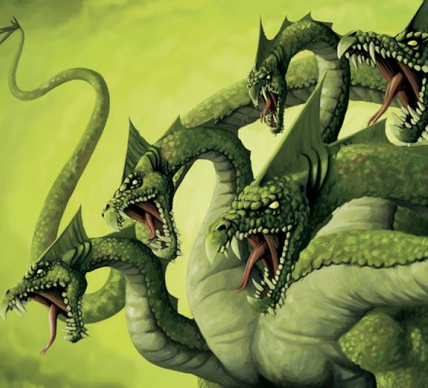
Which monster can you
see in the picture?
A – Medusa
B – a hydra
B – a hydra
C – Godzilla
D – a dragon

Slide 44
Which of these words is not a colour?
A – purpureus
B – azureus
C – ruber
D – mater
D - mater

Slide 45
How did the Greek people get into the Trojan city?
A – in a wooden horse
A – in a wooden horse
B – in a metal duck
C – on a golden fleece
D – on real horses

Slide 46
Which word is the opposite of right in Latin?
A - dexter
B - sinister
B - sinister
C - brevis
D - forte

Slide 47
FINAL QUESTION
Which of these sentences is not correct?
A – agricolas puella amat.
B – puellae amant agricolam.
C – agricola puellam amat.
D – puella agricola amat.
D – puella agricola amat.

