Slide 1
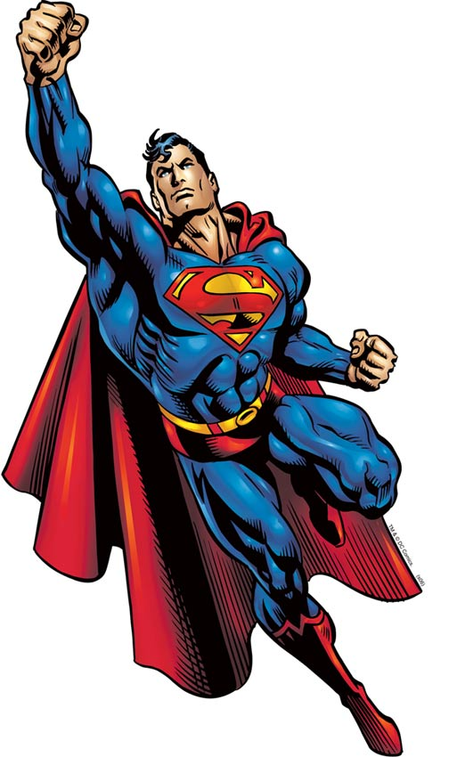
(SUPERVIR!)

Slide 2
SONG!
1,2, -1,2,3 go!
Clap your hands!
Sleep
Wave your hands
Hitch a ride
Sneeze
Go for a walk
Let’s see you swim
Now Ski
Spray
Machoman
Sound your horn
Ring the bell
OK
Kiss
Comb your hair
Wave your hands
Come on, wave your hands!
Superman!

Slide 3
SONG!
PLAUDA MANUS | CLAP YOUR HANDS
DORMI! | SLEEP
VENTILA! | WAVE YOUR HANDS
POLLICES! | HITCH A RIDE
STERNUE! | SNEEZE
AMBULA! | GO FOR A WALK
NATA! | SWIM
IURGE! | SKI
SPARGE! | SPRAY

Slide 4
SONG!
MASCULUS! | MACHO MAN
SONA CORNU! | SOUND YOUR HORN
CONSONA! | RING THE BELL
BENE! | OK
BASIA! | KISS
CARRE CRINES! | COMB YOUR HAIR
VENTILA! | WAVE YOUR HANDS
SUPERVIR!!! | SUPERMAN!!!

Slide 5
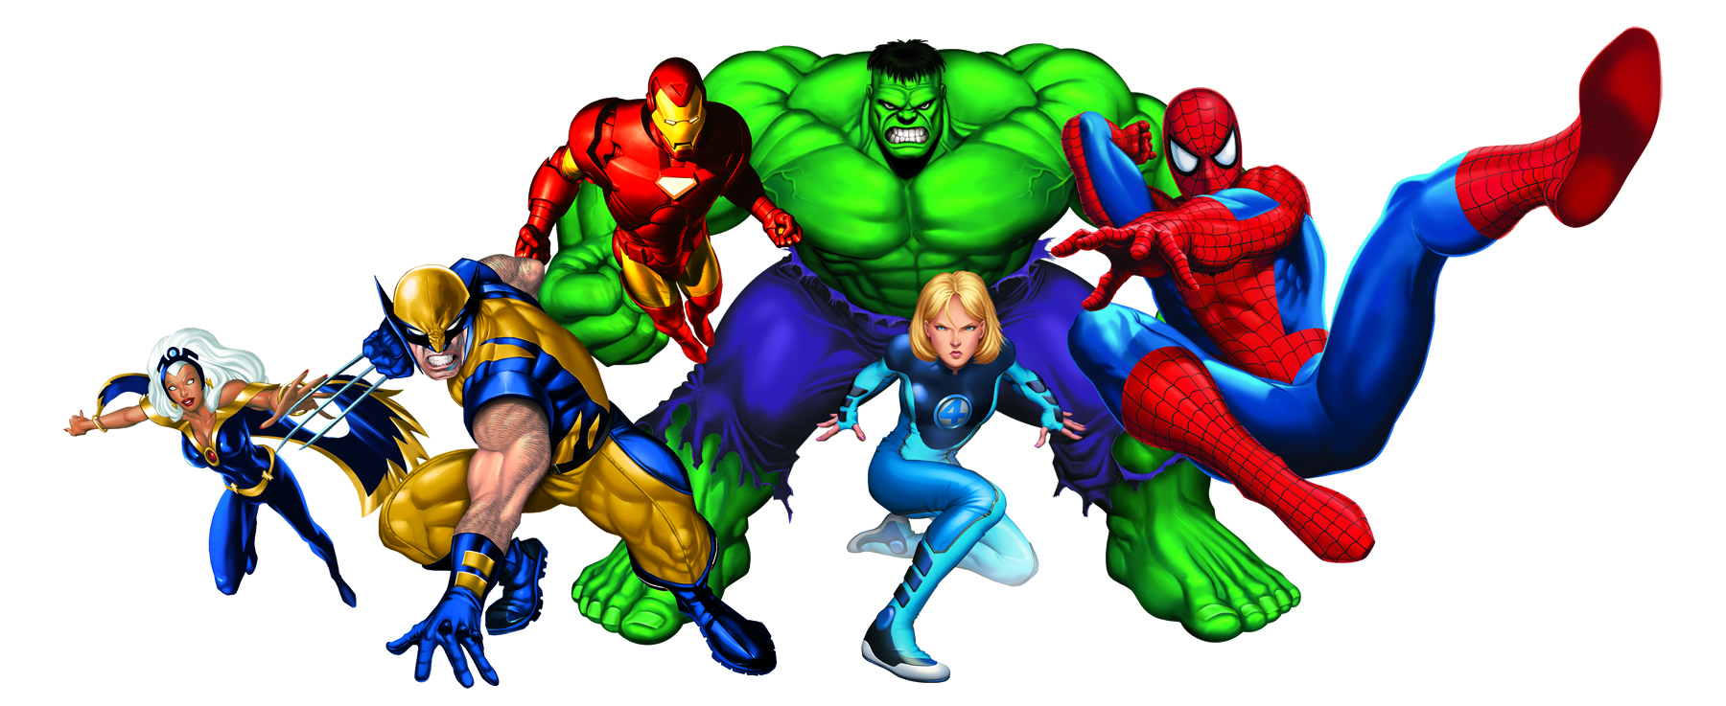
MY SUPERHERO!
My superhero is called .
Use –us for boys names and –a for girls names!

Slide 6
MY SUPERHERO!
He/she is _______ in colour.
flavus
luteus
ruber
niger
purpureus
viridis
albus
roseus
caeruleus

Slide 7
MY SUPERHERO!
He/she is also very ______.
Remember these describing words?
ridiculus - funny
magnus - great
optimus - the best
pulcher - beautiful
bonus - good
valens - strong
sapiens - wise

Slide 8
MY SUPERHERO!
He/she likes to wear a _____.
chlamys - cape
galea - helmet
arma - armour
persona - mask
vestis - suit/dress
gloves - manicae

Slide 9
MY SUPERHERO!
He/she .
volat - flies
legit mentes – reads minds
mutat – change shape
Disapparet - turns invisible
est deus – is a god
est dea – is a goddess
sanat – heals
currit celeriter – runs fast
facit telum - uses a weapon
Facit artem magicam – uses
Magic art
facit karate – uses karate

