Slide 1
Latin
The Romans and our world

Slide 2
What does Latin mean to us?
Do we still use Latin today?
What connections are there
between Latin and how we speak today?
How is Latin relevant to the modern world?

Slide 3
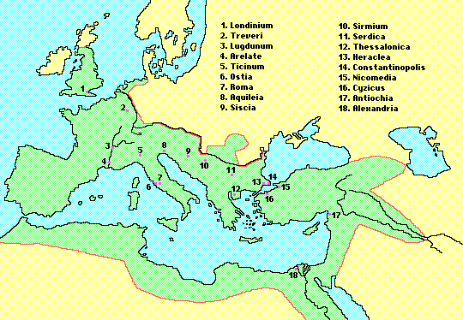
The Roman Empire

Slide 4
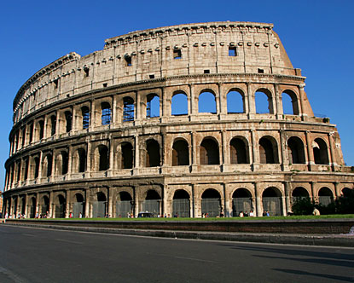
The Colosseum

Slide 5
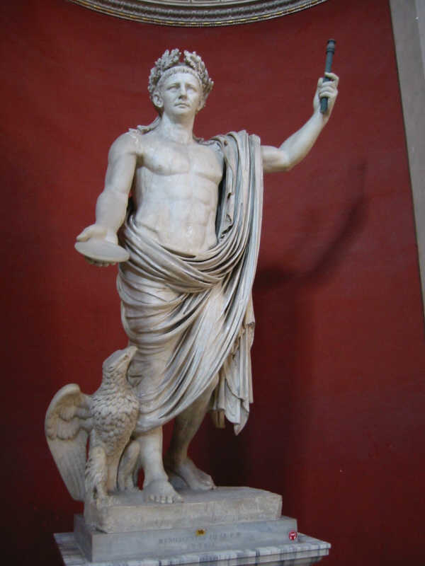
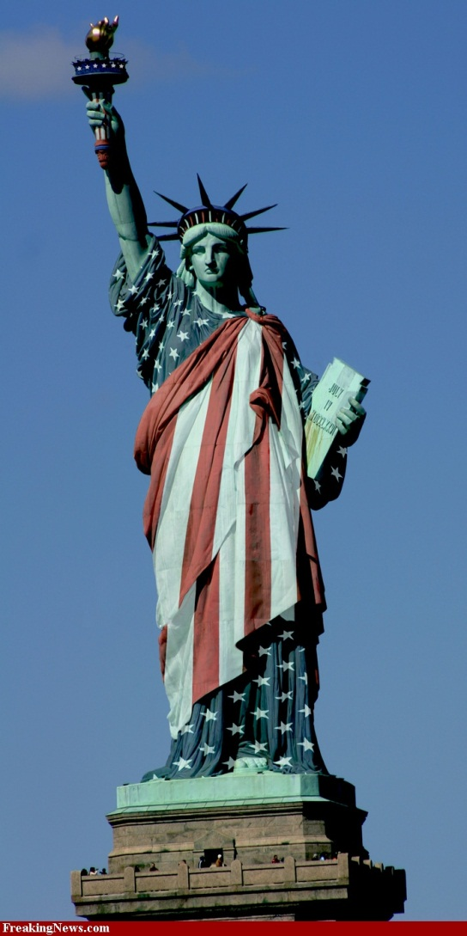
Which of these is Roman?

Slide 6
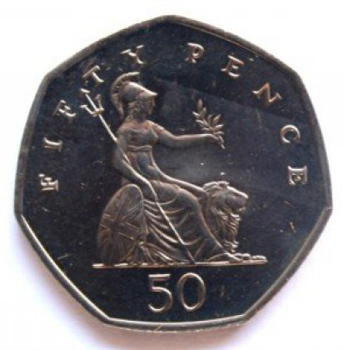
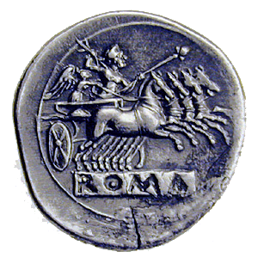
Which one is Roman?

Slide 7
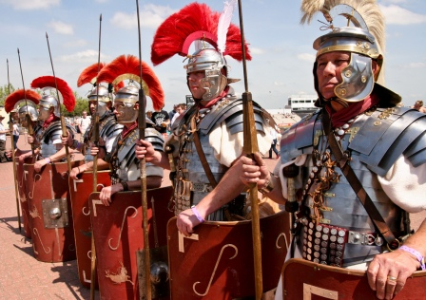
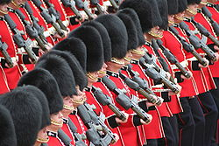
Which of these are Roman?

Slide 8
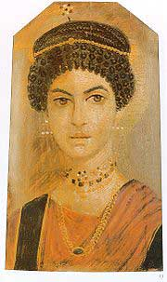
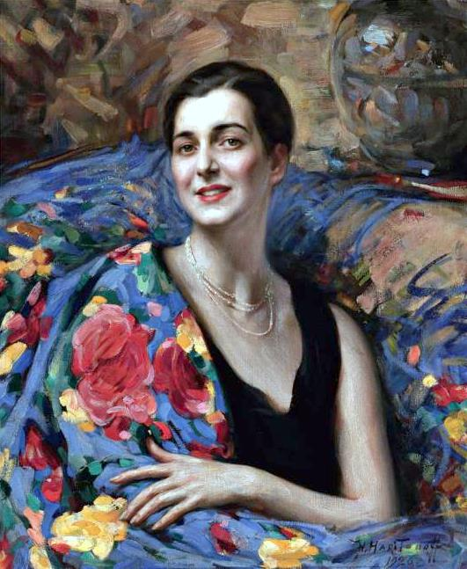
Which one is Roman?

Slide 9
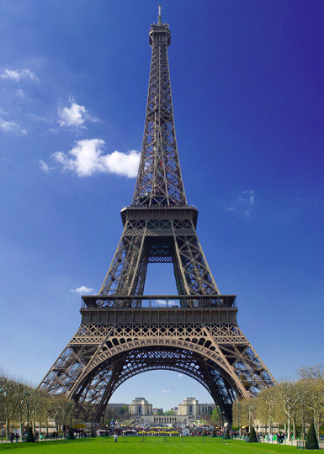
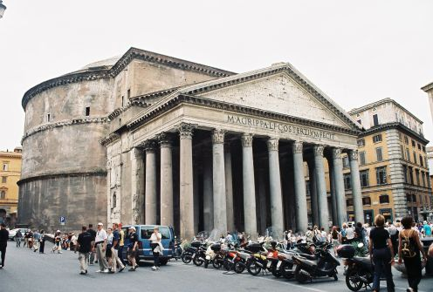
Which one is Roman?

Slide 10
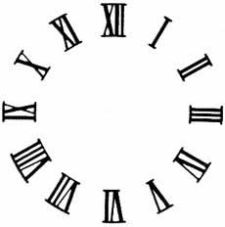
Roman Numerals
I = 1
V = 5
X = 10
L = 50
C = 100

Slide 11
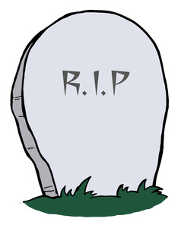
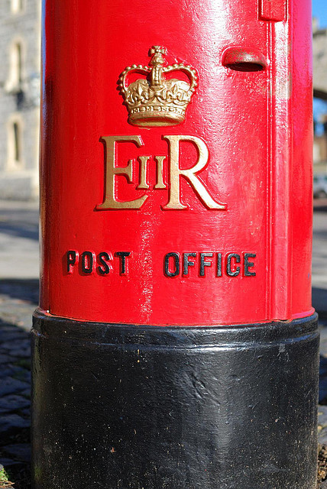
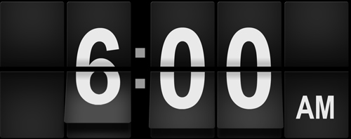
Abbreviations
Requiescat in Pace
Am - Ante Meridiem
"before midday”
Elizabeth II regina

