Slide 1
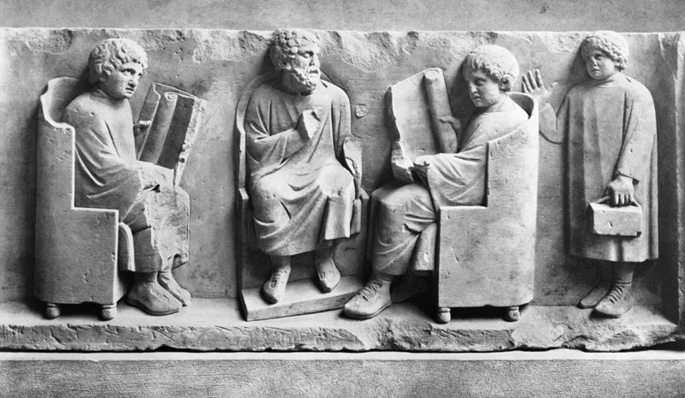
Roman children

Slide 2
Latin noun endings
Can you remember the endings we have seen already?

Slide 3
Many Latin nouns end in -a
Girl = Puell-a
Sailor = Naut-a
Daughter = Fili-a
Table = Mens-a
We have also seen nouns which end in -us
Year = Ann-us
Friend = Amic-us
Slave = Serv-us
Sword = Gladi-us

Slide 4
Compare
The busa was late.
with
I just caught the busam.

Slide 5
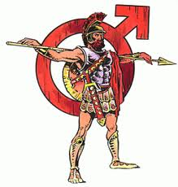
The endings can change
Feminine Masculine
-a -us
-am -um

Slide 6
Feminine
The -a ending is used when the noun is the subject of the sentence
The busa was running late
The subject is the main NOUN in a sentence.

Slide 7
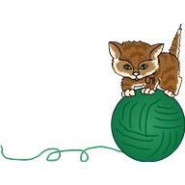
The girl cuddled a kitten
The boy won the race
The mouse nibbled the apple

Slide 8
Subject?
The girl cuddled a kitten
The boy won the race
The mouse nibbled the apple

Slide 9
Direct object
The -am ending is used when
the noun is the direct object in the sentence
The man caught the busam
The direct object is the NOUN that the VERB in the sentence is being done to

Slide 10
Direct object?
The girl cuddled a kitten
The boy won the race
The mouse nibbled the apple

Slide 11
Direct object
The girl cuddled a kitten
The boy won the race
The mouse nibbled the apple

Slide 12
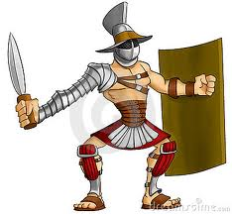
Masculine
Subject = Gladi-us
Direct Object = Gladi-um

Slide 13
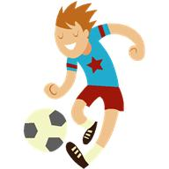
Masculine
So the Latin would look like…
The footballus hit the post
The striker kicked the footballum

Slide 14
See? Not so complicated!
 | Male (Masculine) | Female (Feminine)
Subject | -us | -a
Direct Object | -um | -am

Slide 15
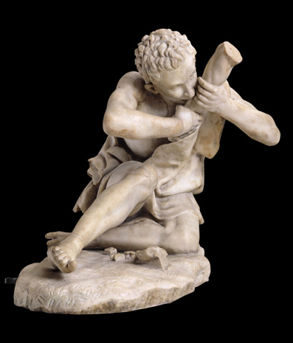
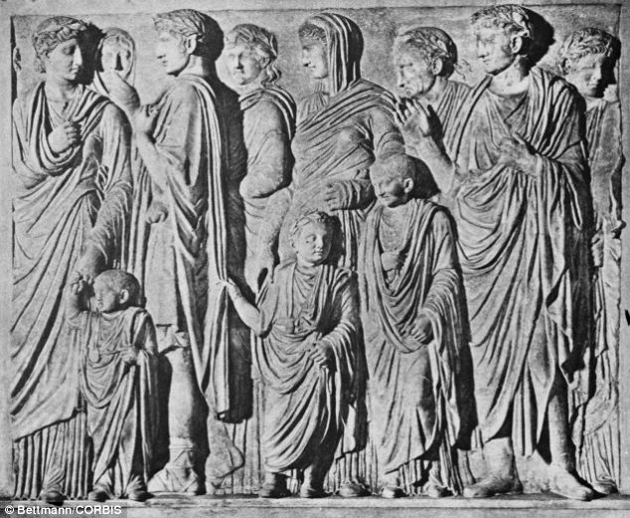
Poor v rich, girls v boys

Slide 16
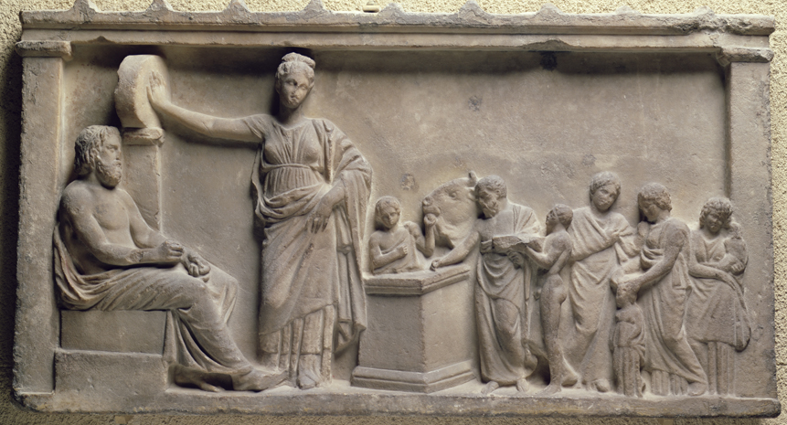
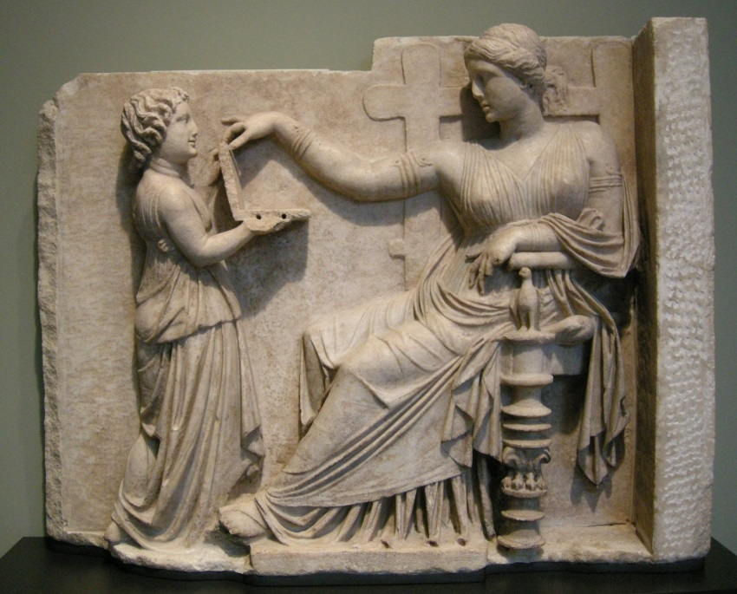
Poor v rich, girls v boys

