Slide 1
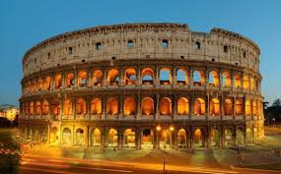
WRITING AND STORYTELLING:
TIMELINE OF
ANCIENT ROME

Slide 2
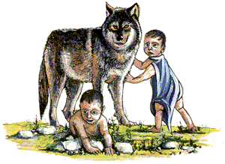
ROMULUS AND REMUS

Slide 3
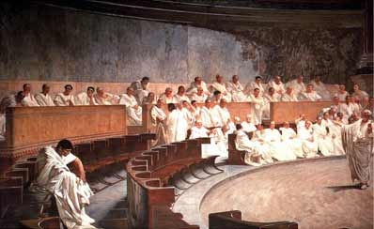
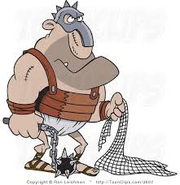
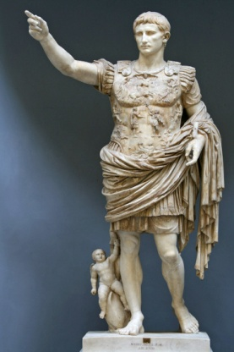
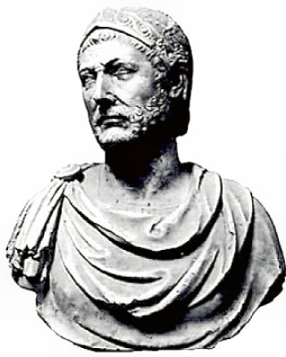
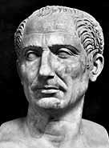
509 BC
73 BC
27 BC
753 BC
218 BC
44 BC

Slide 4
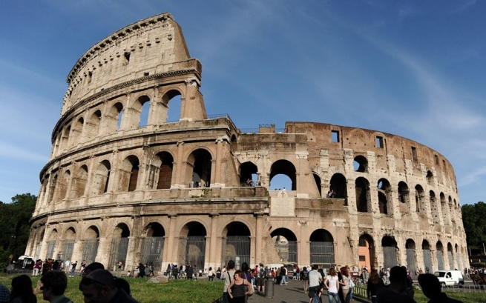
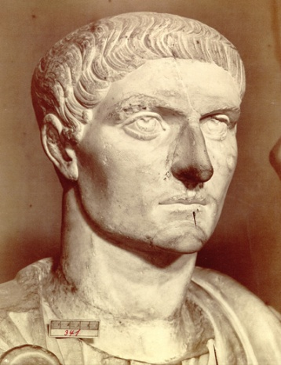
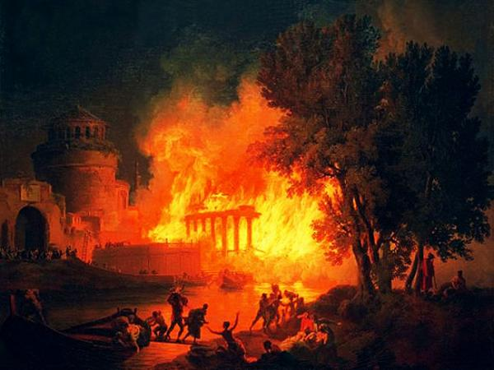
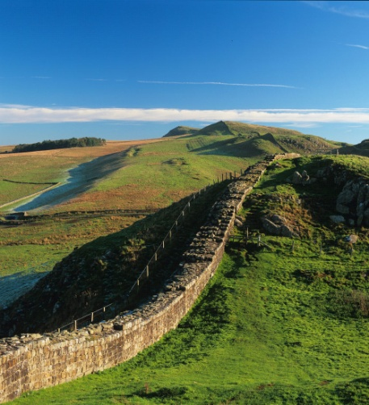
80 AD
306 AD
64 AD
121 AD

Slide 5
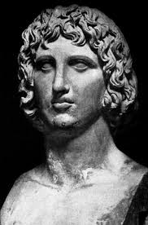
Roman Story Tellers
Rome was renowned for its writers and authors, including its story tellers.
The most famous was Virgil
Virgil

Slide 6
Pandora’s Box

Slide 7
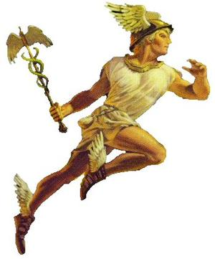
Mercury: God of Story telling

